Slide 1





Axos Client Portal End-Investor Communications
Current Client Registration Email Journey
When working with your CSA, you can elect for Axos to trigger an onboarding journey for your existing clients to register for the Portal.
Click on the Icons to View Emails
New Client Registration Email Journey
Once your firm has been onboarded to the portal, any new clients that you add to your firm will receive an onboarding journey to register for the portal.
Click on the Icons to View Emails
Additional Client Experience Touchpoints
Click on the Icons to View
Initial
Launch Portal
New Client Onboarded
Marketing Touchpoints
9 am Next Day
Current Client Registration
invitation
9 am Next Day
Registration
invitation
+2 Days
Current Client Registration
invitation
Reminder
+2 Days
Registration
invitation
Reminder
Marketing Resources
+7 Days
Current Client Registration
invitation
Reminder
+7 Days
Registration
invitation
Reminder
Disclosures

Slide 2
Axos Client Portal End-Investor Communications
Current Client Registration Email Journey
When working with your CSA, you can elect for Axos to trigger an onboarding journey for your existing clients to register for the Portal.
Click on the Icons to View Emails
New Client Registration Email Journey
Once your firm has been onboarded to the portal, any new clients that you add to your firm will receive an onboarding journey to register for the portal.
Click on the Icons to View Emails
Additional Client Experience Touchpoints
Click on the Icons to View
Initial
Launch Portal
New Client Onboarded
Marketing Touchpoints
9 am Next Day
Current Client Registration
invitation
9 am Next Day
Registration
invitation
+2 Days
Current Client Registration
invitation
Reminder
+2 Days
Registration
invitation
Reminder
Marketing Resources
+7 Days
Current Client Registration
invitation
Reminder
+7 Days
Registration
invitation
Reminder
Disclosures

Slide 3
Axos Client Portal End-Investor Communications
Current Client Registration Email Journey
When working with your CSA, you can elect for Axos to trigger an onboarding journey for your existing clients to register for the Portal.
Click on the Icons to View Emails
New Client Registration Email Journey
Once your firm has been onboarded to the portal, any new clients that you add to your firm will receive an onboarding journey to register for the portal.
Click on the Icons to View Emails
Additional Client Experience Touchpoints
Click on the Icons to View
Initial
Launch Portal
New Client Onboarded
Marketing Touchpoints
9 am Next Day
Current Client Registration
invitation
9 am Next Day
Registration
invitation
+2 Days
Current Client Registration
invitation
Reminder
+2 Days
Registration
invitation
Reminder
Marketing Resources
+7 Days
Current Client Registration
invitation
Reminder
+7 Days
Registration
invitation
Reminder
Disclosures

Slide 4
Axos Client Portal End-Investor Communications
Current Client Registration Email Journey
When working with your CSA, you can elect for Axos to trigger an onboarding journey for your existing clients to register for the Portal.
Click on the Icons to View Emails
New Client Registration Email Journey
Once your firm has been onboarded to the portal, any new clients that you add to your firm will receive an onboarding journey to register for the portal.
Click on the Icons to View Emails
Additional Client Experience Touchpoints
Click on the Icons to View
Initial
Launch Portal
New Client Onboarded
Marketing Touchpoints
9 am Next Day
Current Client Registration
invitation
9 am Next Day
Registration
invitation
+2 Days
Current Client Registration
invitation
Reminder
+2 Days
Registration
invitation
Reminder
Marketing Resources
+7 Days
Current Client Registration
invitation
Reminder
+7 Days
Registration
invitation
Reminder
Disclosures

Slide 5
Axos Client Portal End-Investor Communications
Current Client Registration Email Journey
When working with your CSA, you can elect for Axos to trigger an onboarding journey for your existing clients to register for the Portal.
Click on the Icons to View Emails
New Client Registration Email Journey
Once your firm has been onboarded to the portal, any new clients that you add to your firm will receive an onboarding journey to register for the portal.
Click on the Icons to View Emails
Additional Client Experience Touchpoints
Click on the Icons to View
Initial
Launch Portal
New Client Onboarded
Marketing Touchpoints
9 am Next Day
Current Client Registration
invitation
9 am Next Day
Registration
invitation
+2 Days
Current Client Registration
invitation
Reminder
+2 Days
Registration
invitation
Reminder
Marketing Resources
+7 Days
Current Client Registration
invitation
Reminder
+7 Days
Registration
invitation
Reminder
Disclosures

Slide 6
Axos Client Portal End-Investor Communications
Current Client Registration Email Journey
When working with your CSA, you can elect for Axos to trigger an onboarding journey for your existing clients to register for the Portal.
Click on the Icons to View Emails
New Client Registration Email Journey
Once your firm has been onboarded to the portal, any new clients that you add to your firm will receive an onboarding journey to register for the portal.
Click on the Icons to View Emails
Additional Client Experience Touchpoints
Click on the Icons to View
Initial
Launch Portal
New Client Onboarded
Marketing Touchpoints
9 am Next Day
Current Client Registration
invitation
9 am Next Day
Registration
invitation
+2 Days
Current Client Registration
invitation
Reminder
+2 Days
Registration
invitation
Reminder
Marketing Resources
+7 Days
Current Client Registration
invitation
Reminder
+7 Days
Registration
invitation
Reminder
Disclosures

Slide 7
Axos Client Portal End-Investor Communications
Current Client Registration Email Journey
When working with your CSA, you can elect for Axos to trigger an onboarding journey for your existing clients to register for the Portal.
Click on the Icons to View Emails
New Client Registration Email Journey
Once your firm has been onboarded to the portal, any new clients that you add to your firm will receive an onboarding journey to register for the portal.
Click on the Icons to View Emails
Additional Client Experience Touchpoints
Click on the Icons to View
Initial
Launch Portal
New Client Onboarded
Marketing Touchpoints
9 am Next Day
Current Client Registration
invitation
9 am Next Day
Registration
invitation
+2 Days
Current Client Registration
invitation
Reminder
+2 Days
Registration
invitation
Reminder
Marketing Resources
+7 Days
Current Client Registration
invitation
Reminder
+7 Days
Registration
invitation
Reminder
Disclosures

Slide 8
Axos Client Portal End-Investor Communications
Current Client Registration Email Journey
When working with your CSA, you can elect for Axos to trigger an onboarding journey for your existing clients to register for the Portal.
Click on the Icons to View Emails
New Client Registration Email Journey
Once your firm has been onboarded to the portal, any new clients that you add to your firm will receive an onboarding journey to register for the portal.
Click on the Icons to View Emails
Additional Client Experience Touchpoints
Click on the Icons to View
Initial
Launch Portal
New Client Onboarded
Marketing Touchpoints
9 am Next Day
Current Client Registration
invitation
9 am Next Day
Registration
invitation
+2 Days
Current Client Registration
invitation
Reminder
+2 Days
Registration
invitation
Reminder
Marketing Resources
+7 Days
Current Client Registration
invitation
Reminder
+7 Days
Registration
invitation
Reminder
Disclosures

Slide 9
Axos Client Portal End-Investor Communications
Current Client Registration Email Journey
When working with your CSA, you can elect for Axos to trigger an onboarding journey for your existing clients to register for the Portal.
Click on the Icons to View Emails
New Client Registration Email Journey
Once your firm has been onboarded to the portal, any new clients that you add to your firm will receive an onboarding journey to register for the portal.
Click on the Icons to View Emails
Additional Client Experience Touchpoints
Click on the Icons to View
Initial
Launch Portal
New Client Onboarded
Marketing Touchpoints
9 am Next Day
Current Client Registration
invitation
9 am Next Day
Registration
invitation
+2 Days
Current Client Registration
invitation
Reminder
+2 Days
Registration
invitation
Reminder
Marketing Resources
+7 Days
Current Client Registration
invitation
Reminder
+7 Days
Registration
invitation
Reminder
Disclosures

Slide 10
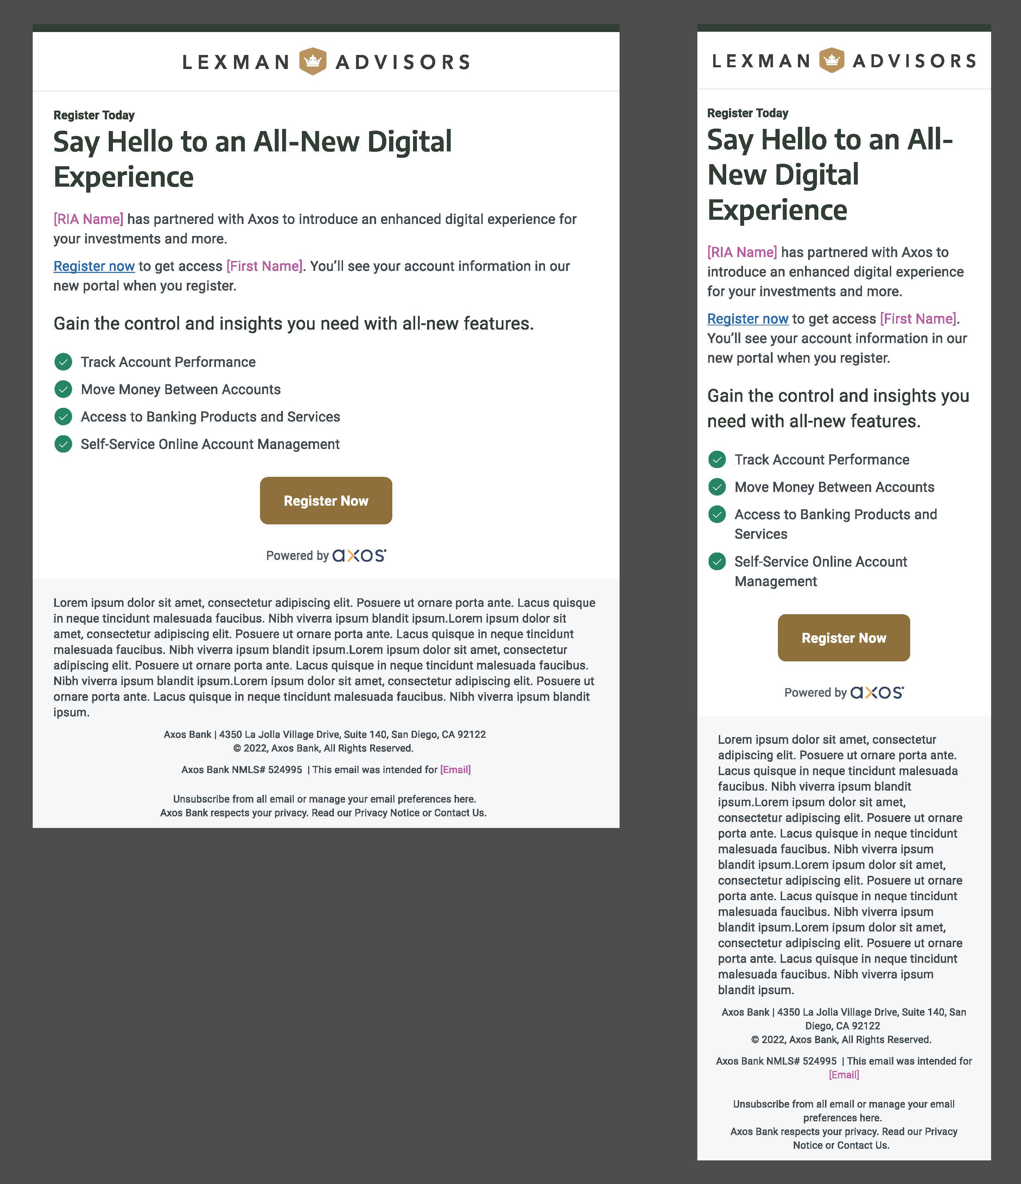


Custom branding for your firm
Custom branding for your firm can be added to the identified areas
Logo
Accent Colors
View Custom Branding Sample
Invitation to Register – Current Clients
Once your portal onboarding is complete, this is the email your current clients will receive to register for the portal.
From: Axos < [Firm]@notifications.axosadvisorservices.com
Subject Line: [Firm Name] - Our new digital experience is here
Preheader: Register now to get access
This email will be sent at 9 am the day after your portal launch
Register Now
Register Now
Disclosures
Hover over to view disclosures
Disclosures
Hover over to view disclosures
Desktop Experience
Return to Main Page
Disclosures
Hover over to view disclosures
Disclosures
Hover over to view disclosures
Mobile Experience

Slide 11
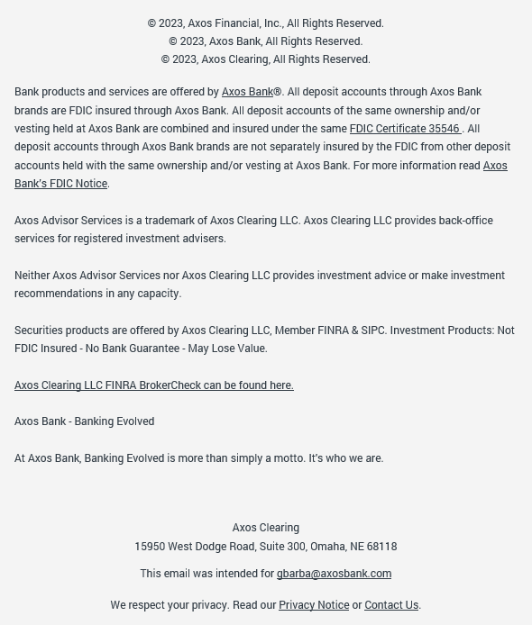
Client’s email address
Return

Slide 12
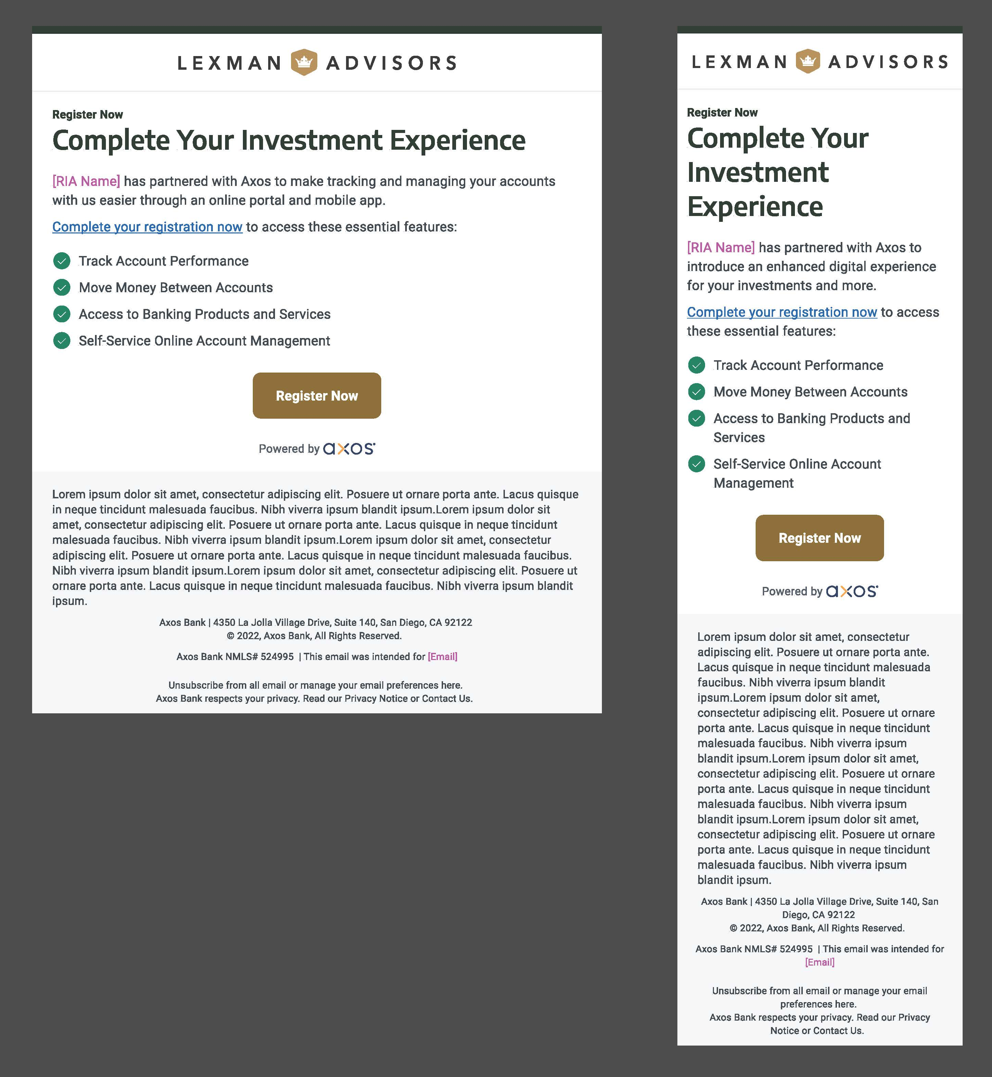
Custom branding for your firm
Custom branding for your firm can be added to the identified areas
Logo
Accent Colors
View Custom Branding Sample
Invitation to Register – New Clients
When onboarding new clients to your firm, you can provide them your custom registration link (provided during your onboarding consultation) this is the email they will receive to register to view their account information.
From: Axos < [Firm]@notifications.axosadvisorservices.com
Subject Line: Firm Name - Register now to use our online and mobile features
Preheader: Access our portal at home or on the go – register today!
This email will be sent at 9 am the day after their new account application is submitted and approved.
Register Now
Register Now
Disclosures
Hover over to view disclosures
Desktop Experience
Disclosures
Hover over to view disclosures
Return to Main Page
Mobile Experience

Slide 13
Client’s email address
Return

Slide 14
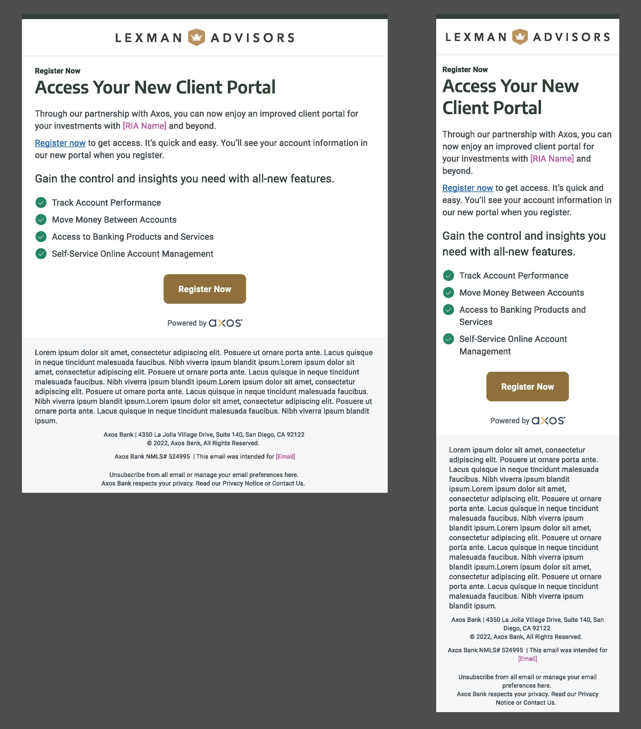
Custom branding for your firm
Custom branding for your firm can be added to the identified areas
Logo
Accent Colors
View Custom Branding Sample
Invitation to Register Reminder – Current Clients
This is the reminder email that will go out to your current clients who did not register through the initial email invitation.
From: Axos < [Firm]@notifications.axosadvisorservices.com
Subject Line: Firm Name - Our new digital experience is here
Preheader: Register now to get access
This email will be sent two days after the invitation email. If a client does not register from either of those emails, one more reminder email will be sent seven days after this reminder.
Register Now
Register Now
Disclosures
Hover over to view disclosures
Desktop Experience
Disclosures
Hover over to view disclosures
Return to Main Page
Mobile Experience

Slide 15
Client’s email address
Return

Slide 16

Custom branding for your firm
Custom branding for your firm can be added to the identified areas
Logo
Accent Colors
View Custom Branding Sample
Invitation to Register Reminder – New Clients
This is the reminder email that will go out to your newly onboarded clients who did not register through the initial email invitation.
From: Axos < [Firm]@notifications.axosadvisorservices.com
Subject Line: Firm Name - Reminder: Register to access our new online portal
Preheader: It’s quick and easy.
This email will be sent two days after the invitation email. If a client does not register from either of those emails, one more reminder email will be sent seven days after this reminder.
Register Now
Register Now
Disclosures
Hover over to view disclosures
Desktop Experience
Disclosures
Hover over to view disclosures
Return to Main Page
Mobile Experience

Slide 17
Client’s email address
Return

Slide 18
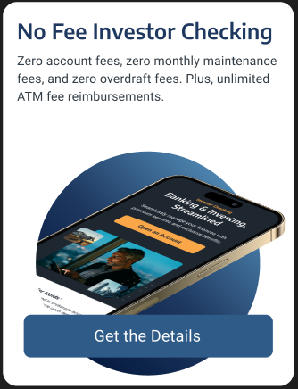
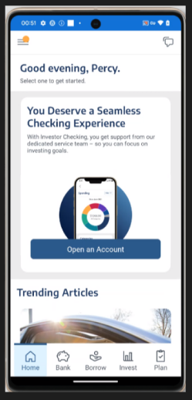
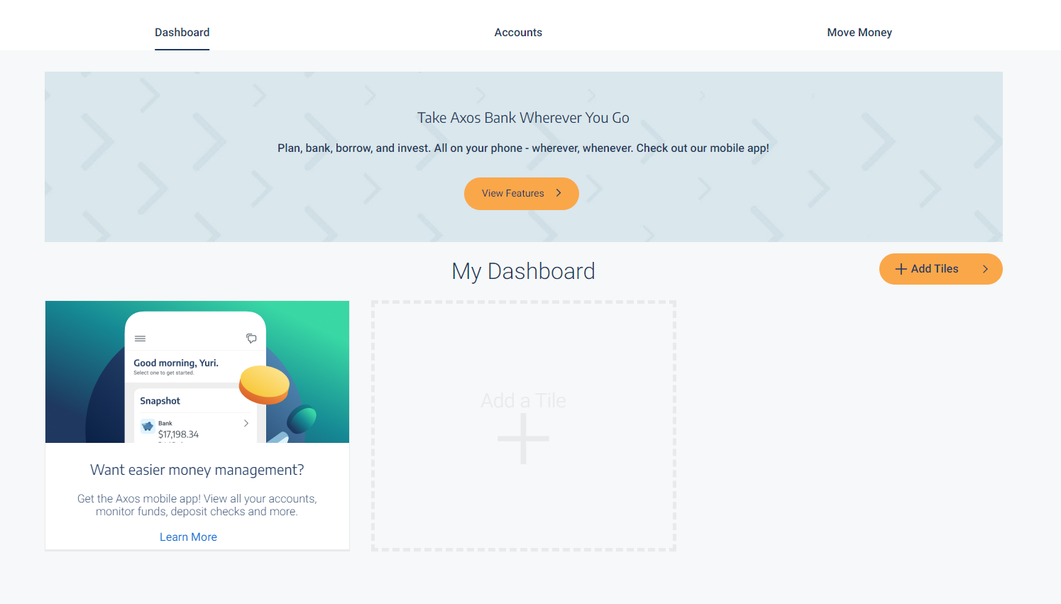




Product Marketing Touchpoints
End Investor enrolled in Investor Checking or has a previous banking relationship with Axos.
Experience according to their personal attributes profile.
In-App Marketing Tile
Desktop Banner Marketing
Yes, end investors will see in-app or desktop banner advertisements for banking solutions
Yes, end investors will receive email marketing about banking products, unless opted-out
Product Marketing Email Sample
Potential Solutions Marketed on the Platform
Deposit Products
Investor Checking
InsureGuard+
Loans
Auto
Personal
Mortgage
Rate Check
Deposit Services
Direct Deposit
Bill Pay
Portal Services
Credit Score
Aggregation
Spending Analysis
Biometrics
Mobile App
Contact Info Update
Click the box to see a sample
End Investor did not enroll in Investor Checking when registering for the Portal.
Experience according to their personal attributes profile.
CLICK + STARTS/COMPLETES APPLICATION
If your client clicks on an in-app or desktop banner advertisement either starts or completes an application, your client will receive emails specific to that product and status - for Example, an Investor Checking abandoned application email.
Yes, end investors will see in-app or desktop banner advertisements for banking solutions
No, end investors will not receive email marketing about banking products
Return to Main Page

Slide 19
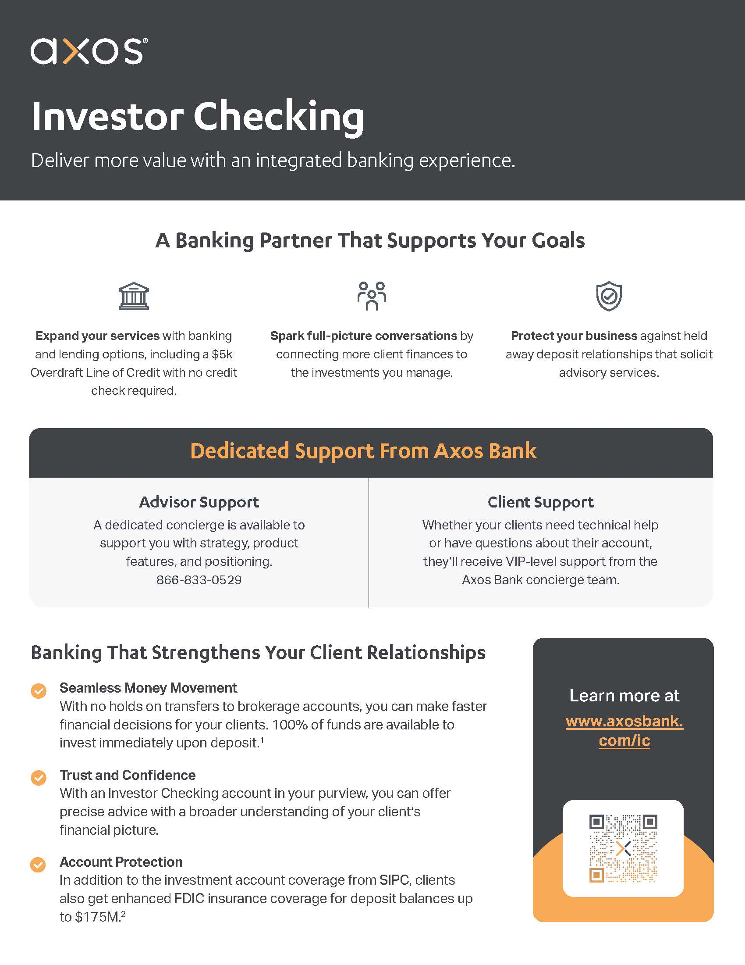
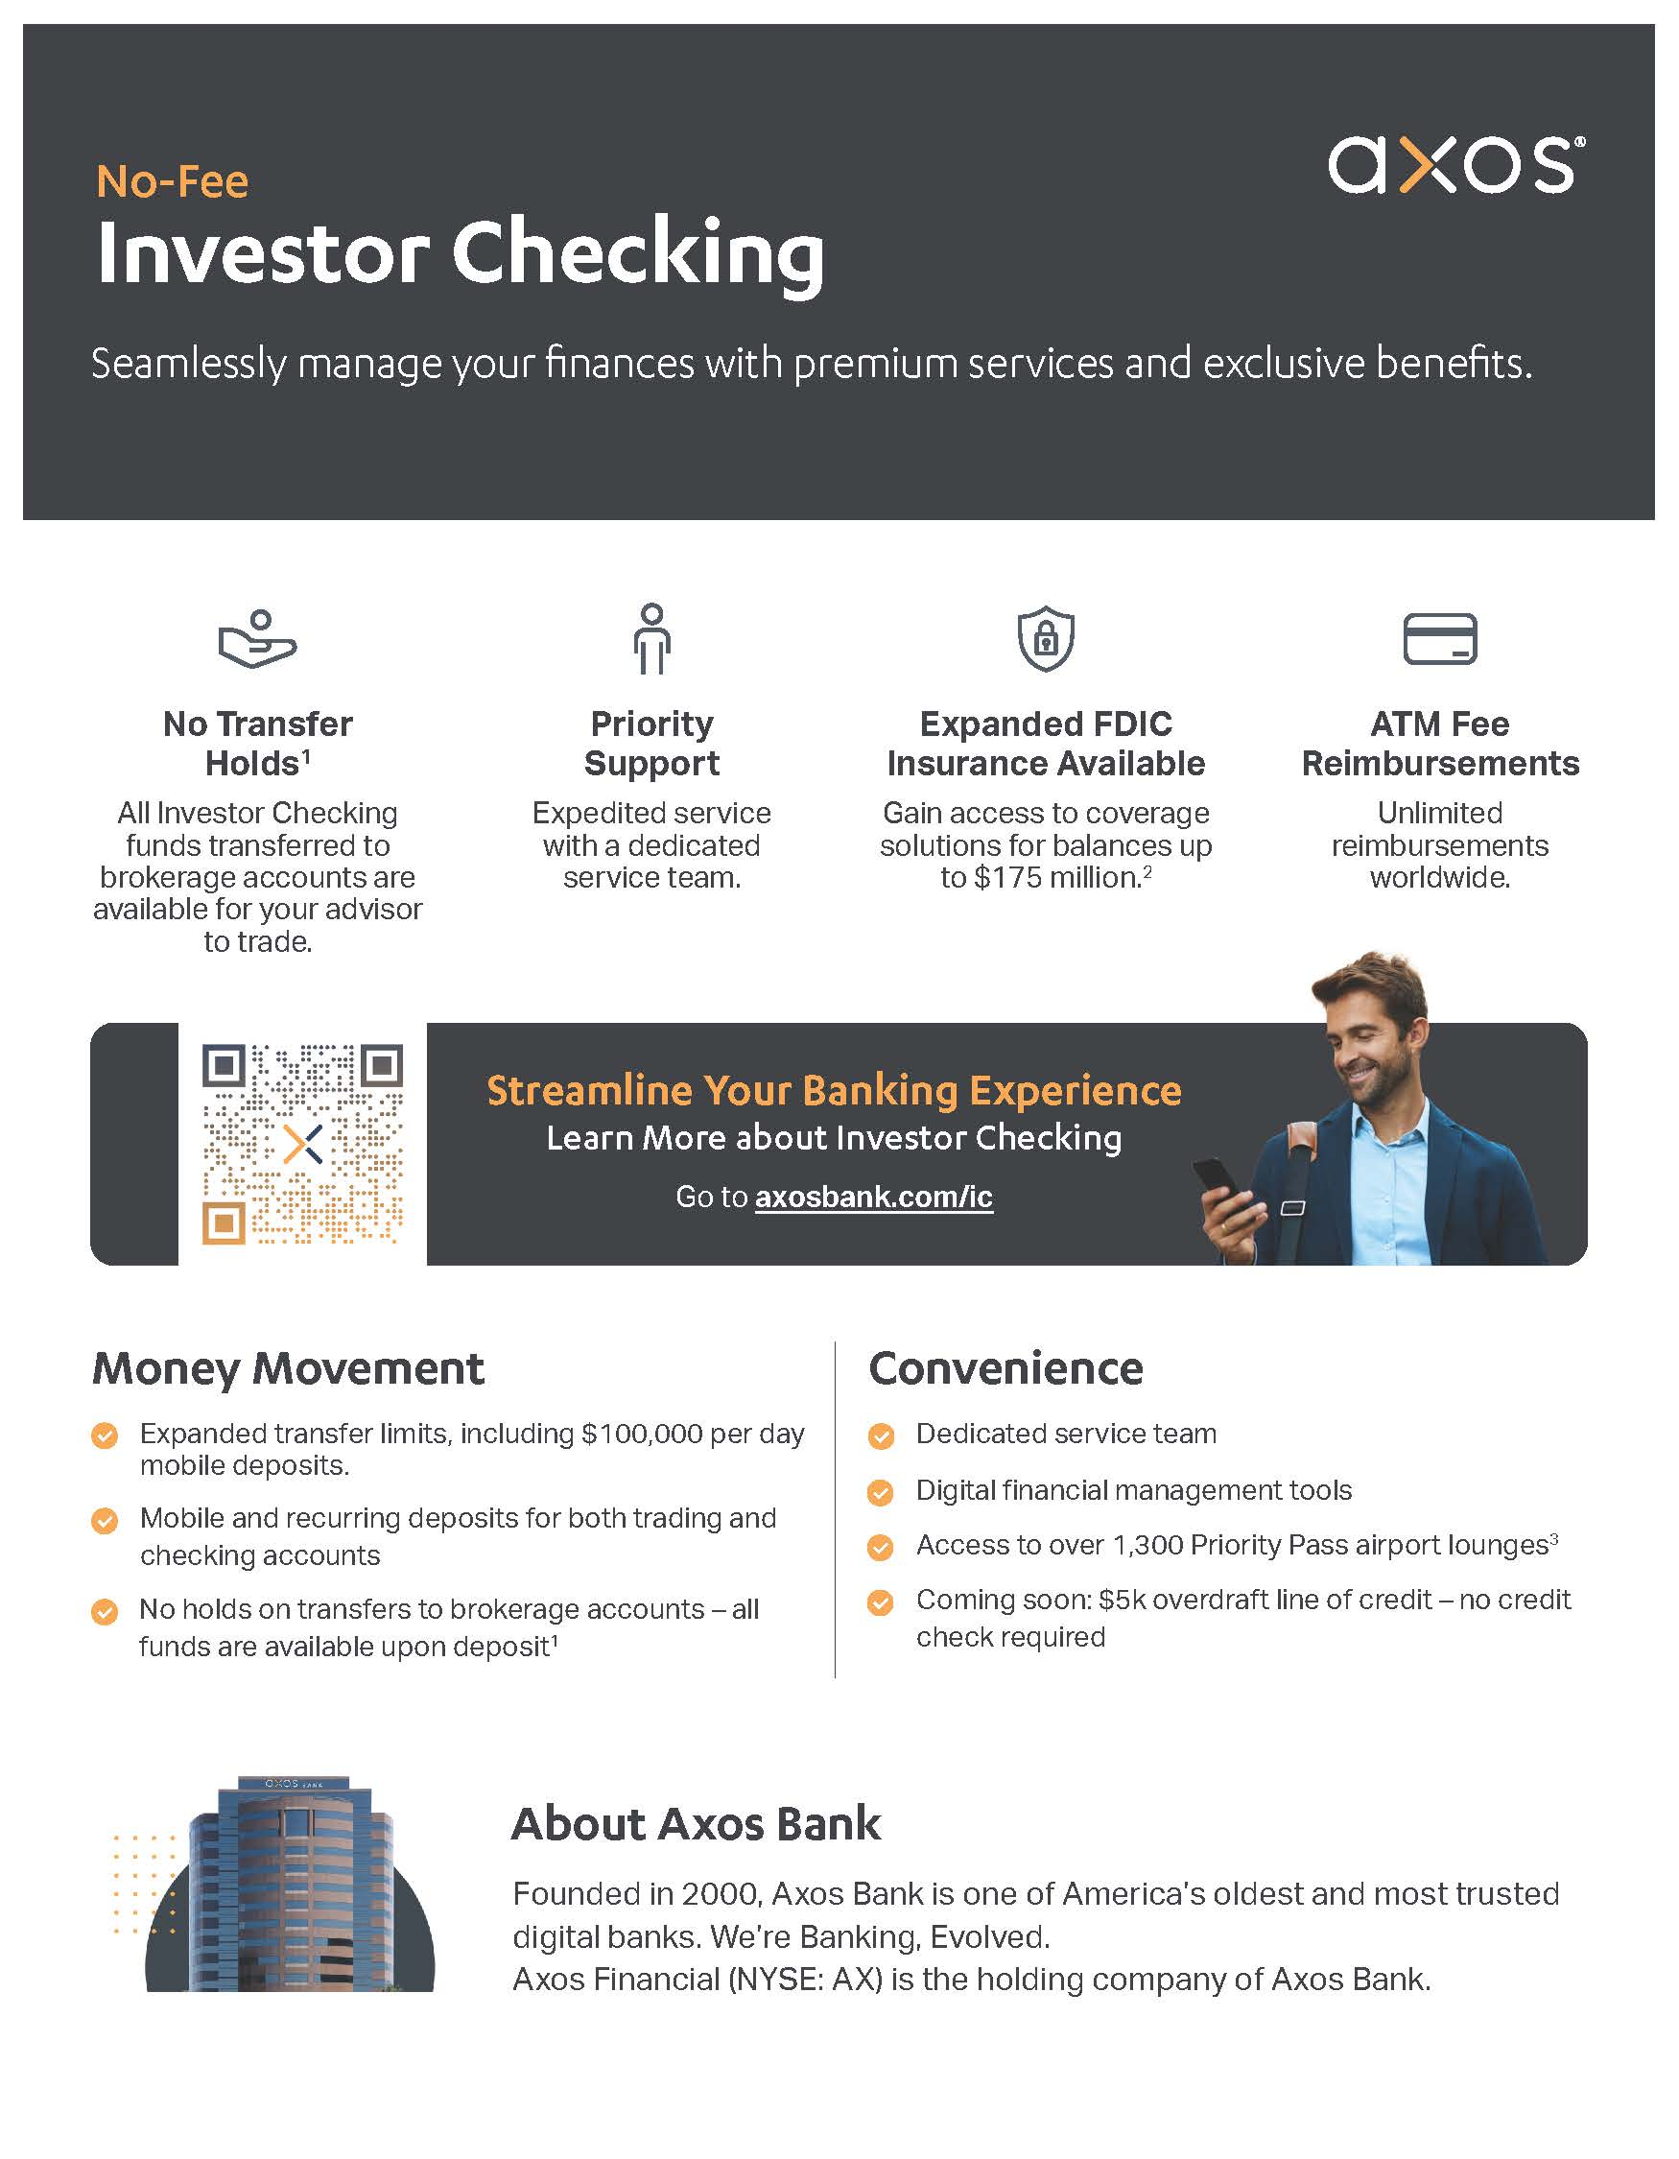
Product Resources for Advisors and End-Investors
Informational flyer about Investor Checking for Advisors
Want to know more about Investor Checking? This informational flyer will assist your firm and advisors in understanding how the product works and how it could benefit your clients.
Informational flyer about Investor Checking for End-Investors
Want to promote Investor Checking to your clients? This informational flyer will assist your clients in understanding the Investor Checking product and the benefits of partnering with you.
Return to Touchpoints
Return to Main Page

Slide 20
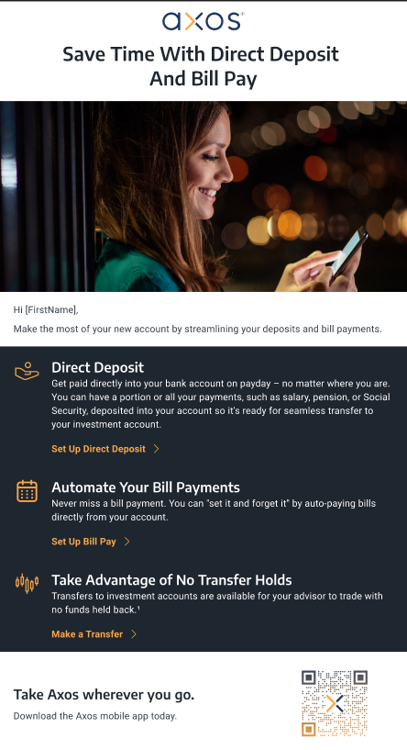

Product Marketing – Email Example
Email Marketing Samples – Direct Deposit
Banking product email marketing will only be sent to clients who have enrolled in Investor Checking or have a previous relationship with Axos.
Email Marketing Samples – Overdraft Line of Credit
Banking product email marketing will only be sent to clients who have enrolled in Investor Checking or have a previous relationship with Axos.
Return to Touchpoints
Return to Main Page

Slide 21
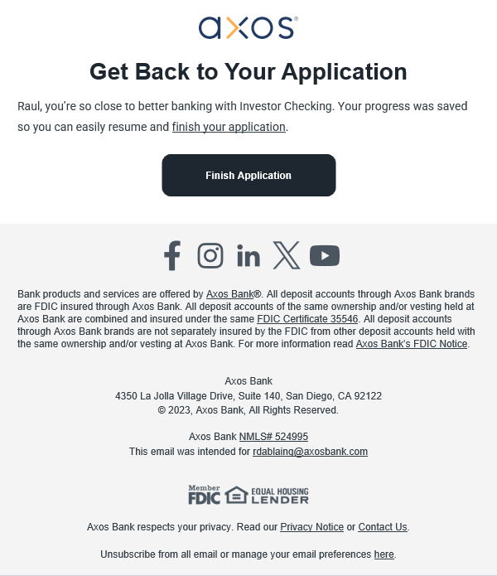
Investor Checking Abandoned Application – Email Example
Email Communication Sample
This is an example of an email your client would receive if they started the Investor Checking application but weren’t able to complete it.
Return to Touchpoints
Return to Main Page

Slide 22
Custom branding for your firm
Custom branding for your firm can be added to the identified areas
Logo
Accent Colors
Invitation to Register – Current Clients
Once your portal onboarding is complete, this is the email your current clients will receive to register for the portal.
From: Axos < [advisor]@notifications.axosadvisorservices.com
Subject Line: A new digital experience for [firm name] is here!
Preheader: Register now to get access
This email will be sent at 9 am the day after your portal launch
Disclosures
Hover over to view disclosures
Desktop Experience
Return to Main Page
Disclosures
Hover over to view disclosures
Mobile Experience

Slide 23
© 2023 Axos Financial, Inc., All Rights Reserved. © 2023 Axos Bank, All Rights Reserved.
© 2023 Axos Invest LLC. Member FINRA & SIPC. All Rights Reserved.
© 2023 Axos Invest, Inc. All Rights Reserved.
Bank products and services are offered by Axos Bank®. All deposit accounts through Axos Bank brands are FDIC insured through Axos Bank. All deposit accounts of the same ownership and/or vesting held at Axos Bank are combined and insured under the same FDIC Certificate 35546. All deposit accounts through Axos Bank brands are not separately insured by the FDIC from other deposit accounts held with the same ownership and/or vesting at Axos Bank. For more information read Axos Bank’s FDIC Notice.
© 2023 Axos Clearing LLC. Member FINRA & SIPC. All Rights Reserved. Axos Advisor Services is a trademark of Axos Clearing LLC. Axos Clearing LLC provides back-office services for registered investment advisers. Neither Axos Advisor Services nor Axos Clearing LLC provides investment advice or make investment recommendations in any capacity. Securities products are offered by Axos Clearing LLC, Member FINRA & SIPC. Investment Products: Not FDIC Insured - No Bank Guarantee - May Lose Value.
Securities and other non-deposit investment products and services are not deposits, obligations of or guaranteed by Axos Bank, are not insured by the FDIC or any governmental agency, and are subject to investment risk including possible loss of the principal invested. Past performance of a security does not guarantee future results or success.
Axos Invest LLC, Axos Invest, Inc., and Axos Bank are separate but affiliated companies.
Axos Bank NMLS# 524995
Return to Touchpoints
Return to Main Page

